Slide 1
Python Tutorial
전 과대 한승혁

Slide 2
Why Python 3
Easy to learn
Easy to write code
Big Community support
Web development
Data Science
Machine learning
Artificial Intelligence
Easy image processing
Rich in libraries

Slide 3
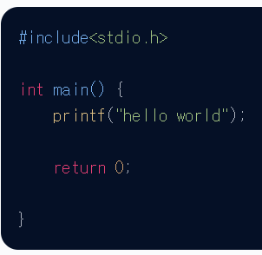
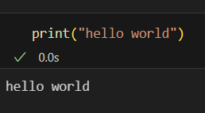
Syntax of Python

Slide 4

Python Environment: Anaconda Setup

Slide 5
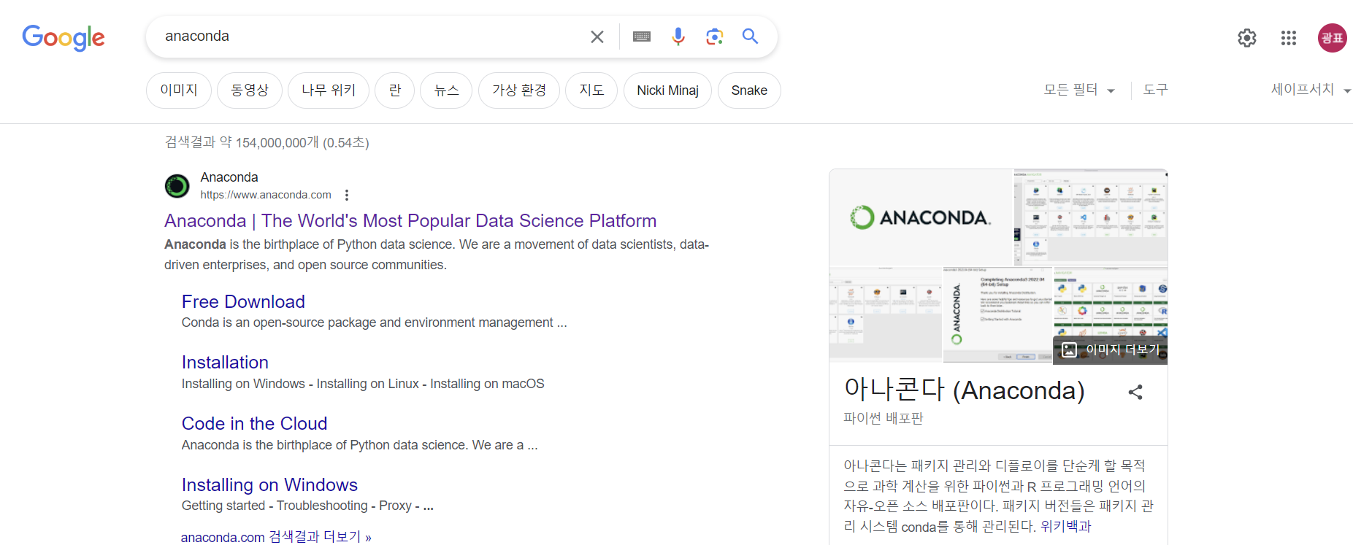
1. Go to Google and type Anaconda

Slide 6
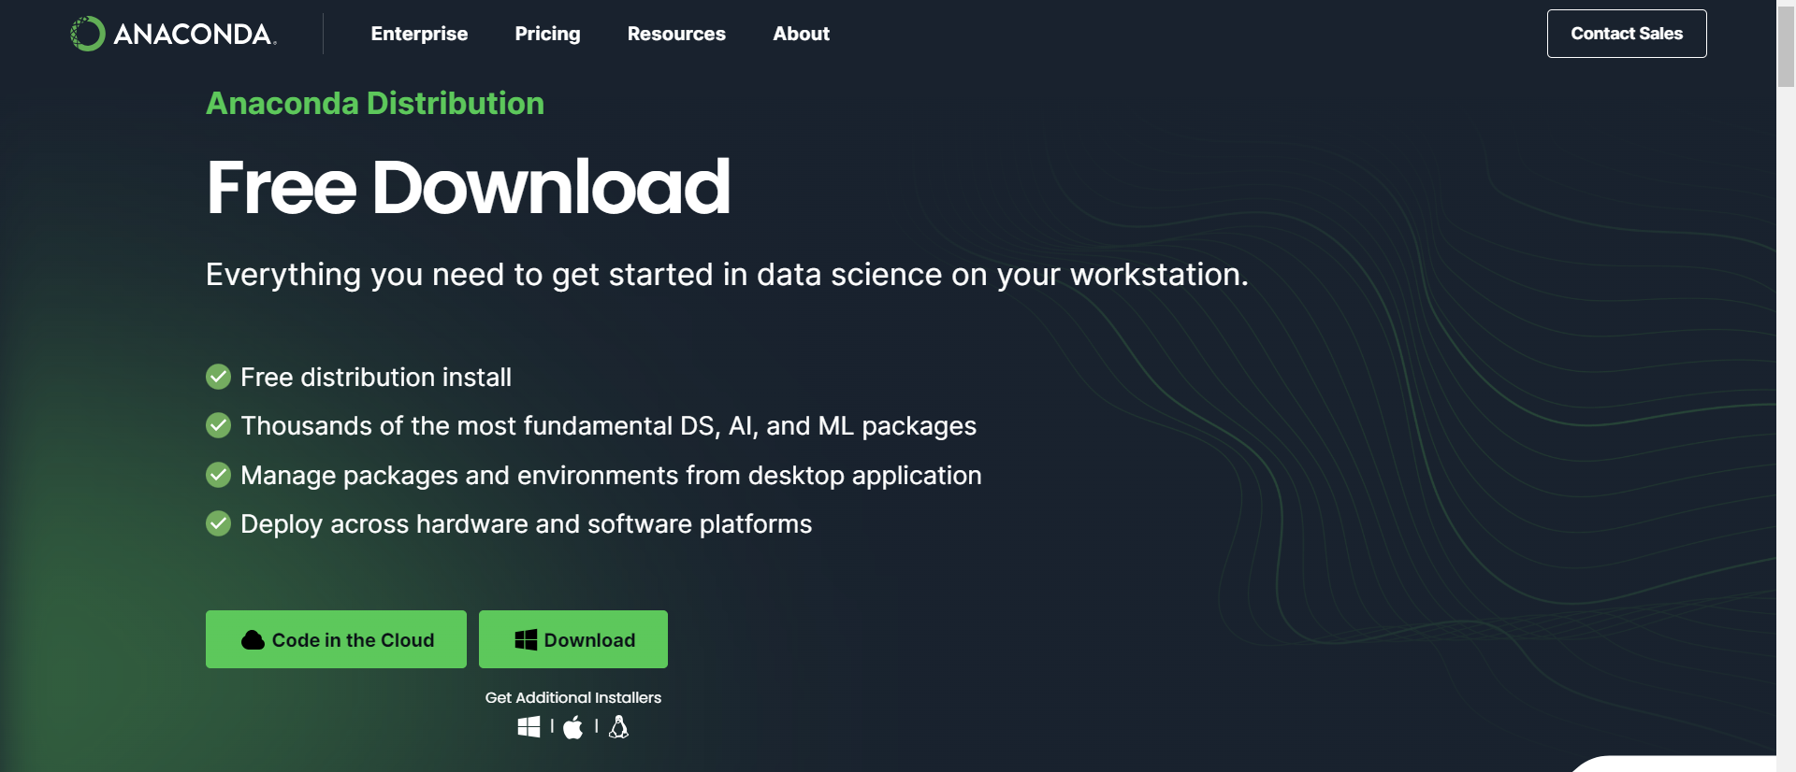
2. Click download

Slide 7
Python Variables
x = 20
y = “I am a variable”
z = ‘I am also a variable’
print(x)
print(y)
print(z)
20
I am a variable
I am also a variable

Slide 8
Python Variables
x = 20 #integer type
x = “aVariable” #string type
print(x) #no errors
aVariable

Slide 9
Variable Naming Scheme
A variable name must start with a letter or the underscore character
A variable name cannot start with a number
A variable name can only contain alpha-numeric characters and underscores (A-z, 0-9, and _ )
Variable names are case-sensitive (age, Age, and AGE are three different variables)
#legal variable names
Var = 1
yourVar = “var”
_var = 1905
_Thisvar = “Not Bad”
My_Var = “Good”
MyVar = “Best
# illegal variable names
-variable = 12
1variable = “badVarname”
my Variable = “error”

Slide 10
Assigning Multiple Variable In One Line
x, y, z = 1, 2, 3
print(x)
print(y)
print(z)
1
2
3
x = y = z = “Hello everyone!”
print(x)
print(y)
print(z)
Hello everyone!
Hello everyone!
Hello everyone!

Slide 11
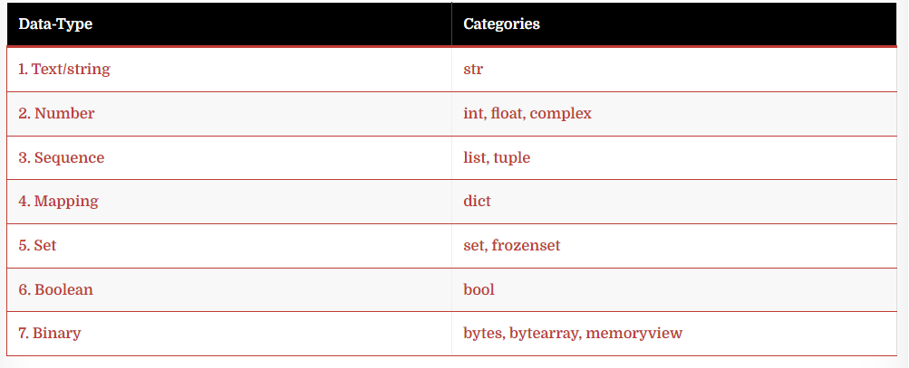
Python Datatypes

Slide 12
Python Datatypes: type() in Python
x = 2
y = " I don't know what to say "
z = ["list", 1]
print(type(x))
print(type(y))
print(type(z))
<class 'int'>
<class 'str'>
<class 'list'>

Slide 13
Python Datatypes: Type Casting
var1 = 20.3
var2 = int(var1) # to int type
var3 = complex(var1) # to complex type
var4 = str(var1) # to str type
print(var1, "Type is", type(var1))
print(var2, "Type is", type(var2))
print(var3, "Type is", type(var3))
print(var4, "Type is", type(var4))
20.3 Type is <class 'float’>
20 Type is <class 'int’>
(20.3+0j) Type is <class 'complex’>
20.3 Type is <class 'str'>

Slide 14
Numeric Datatypes
x = 12
y = 12.3
z = 12j #j instead of i
print(type(x))
print(type(y))
print(type(z))
<class 'int'>
<class 'float'>
<class 'complex'>

Slide 15
Numeric Datatypes: Int
x = 134893563289
y = -23579848294
z = 0
print(type(x))
print(type(y))
print(type(z))
<class 'int'>
<class 'int'>
<class 'int'>

Slide 16
Numeric Datatypes: Float
x = 4352.23456
y = -34256.9232
z = 0.43546
print(type(x))
print(type(y))
print(type(z))
<class 'float'>
<class 'float'>
<class 'float'>

Slide 17
Numeric Datatypes: Complex
x = 12 + 3j
y = -12 - 0.4j
z = 4j
print(type(x))
print(type(y))
print(type(z))
<class 'complex'>
<class 'complex'>
<class 'complex'>

Slide 18
Python Strings
print("Hello! I am a string")
print('Hello! I am also a string')
Hello! I am a string
Hello! I am also a string

Slide 19
Assigning String to Variable
a = "Hello"
b = """This is
a multiline
string"""
c = '''This is
also a multiline
string'‘’
print(a)
print(b)
print(c)
Hello
This is
a multiline
string
This is
also a multiline
string

Slide 20
Indexing in Strings
Python provides both types of indexing i.e. positive and negative.
Positive indexing starts from the left end with “0” and negative indexing starts from the right end with “-1“.

Slide 21
String Slicing:[start:end(-1):step]
mystr = "I am a string"
print(len(mystr))
print(mystr[0])
print(mystr[1])
print(mystr[0:len(mystr)])
print(mystr[:])
print(mystr[-2:-1])
print(mystr[-14:-1])
print(mystr[:100])
print(mystr[0:13:3])
13
I
I am a string
I am a string
n
I am a strin
I am a string
Im rg

Slide 22
String Concatenation
x = "Hello "
y = "World"
z = x + y
print(x + y)
print("Hello " + "World")
print(z)
Hello World
Hello World
Hello World

Slide 23
String Concatenation
x = "2"
y = "4“
print("12.3" + "34.6“)
print(x + y)
print(int(x) + int(y))
12.334.6
24
6

Slide 24
Comma(,) in print() statement
print("This name is", “Khan")
print("My number is", 35)
This name is Khan
My roll number is 35

Slide 25
end() in print() statement
print("Hello")
print("World")
print("Hello", end="")
print("World")
print("Hello", end=" ")
print("World")
print("Hello", end=" my ")
print("World")
Hello
World
HelloWorld
Hello World
Hello my World

Slide 26
format() method
print("Name:{name} and age:{age}".format(name=“Han", age=23))
print("Name:{0} and age:{1}".format("Han", 23))
print("Name:{1} and age:{0}".format("Han", 23))
print("Name:{} and age:{}".format("Han", 23))
Name:Han and age:23
Name:Han and age:23
Name:23 and age:Han
Name:Han and age:23

Slide 27
Fast String
name = "Han"
age = 23
print(f"Name:{name} and age:{age}")
print(f"Addition:{5+4}")
print(f"Multiplication:{eval('1+2//4-20*9')}")
Name:Han and age:23
Addition:9
Multiplication:179

Slide 28
random
Import random
num = random.randint(1, 10)
print(f"Random integer: {num}")
my_list = [1, 2, 3, 4, 5]
choice = random.choice(my_list)
print(f"Random choice: {choice}")
Random integer: 9
Random choice: 4

Slide 29
input()
name = input(“Enter your name: “)
age = int(input(“Enter your age: “)

Slide 30
Quiz 1
Store your name in a variable and print it backwards
name =input(“Enter your name: “)
reversed_name = name[::-1]
print(“If I spell my name backwards: ", reversed_name)

Slide 31
lower() & upper() method
mystr = “ColcHao”
print(mystr.lower())
print(mystr.upper())
colchao
COLCHAO

Slide 32
replace() Method
mystr = “CDSD is for everyone.”
print(mystr.replace(“everyone”, “me”)
CDSD is for me

Slide 33
Escape Characters
print("I am \"a\" sexy guy")
print("Printing in \nNew Line")
print("Printing with a \ttab space")
print("Printing a single quote\'")
print(“I am “A” sexy guy”)
File “C:/vscode/python/escape.py", line 1
print("I am "A" sexy guy")
^
SyntaxError: invalid syntax
I am “a” sexy guy
Printing in
New Line
Printing with a tab space
Printing a single quote’

Slide 34
Python Operators
a = 10, b = 5
Operator | Description | Example
+ (Addition) | It is used to add two operands. | a+b=15
– (Subtraction) | It is used to subtract the second operand from the first operand. | a-b=5
* (Multiplication) | Used to multiply two operands. | a*b=50
/ (divide) | Used to divide the first operand by the second and results in the quotient. | a/b=2.0
% (reminder) | Returns the remainder after dividing the first operand by the second operand. | a%b=0
** (Exponent) | Returns the result after calculating the first operand to the power of the second operand. | a**b=100000
// (Floor division) | It returns the floor value of the quotient produced by dividing the two operands. | a//b=2

Slide 35
Assignment Operators
Operator | Description | Example
= | Simply assigns right side expression to left side operand | a=5
+= | Adds left operand to right side operand and assigns the value back to left operand | a += b is same as a = a+b
-= | Decreases left operand value by right operand value and assign value back to left operand | a -= b is same as a = a-b
*= | Multiply the left operand value with the right operand value and assigns the multiplied value back to the left operand | a *= b is same as a=a*b
%= | Divides left operand by right operand and return remainder which is assigned to left operand | a %= b is same as a=a%b
**= | Increases left operand to power of right operand and assign the result to left operand | a **= b is same as a=a**b
//= | It returns the floor value as it divides the left operand by the right operand and assigns the result to the left operand | a //= b is same as a=a//b

Slide 36
Logical Operators
Operator | Explanation
and | Let two expressions be a==>True, b==>True then the expression a and b will be True while if anyone from a and b is False then the expression will be False
or | Let two expressions be a==>False, b==>False then the expression a and b will be False while if anyone from a and b is True then the expression will be True
not | if a is True then not a is False and vice-versa

Slide 37
List
myList = [1, 2, 3, 4, "Hello", "World"]
print(myList)
print(myList[0])
print(myList[5])
print(myList[-1])
[1,2,3,4,’Hello’,’World’]
1
‘World’
‘World’

Slide 38
List Slicing
myList = [1, 2, 3, 4, "Hello", "World"]
print(myList[1:4])
print(myList[-4:-1])
print(myList[:6])
print(myList[0:])
[2, 3, 4]
[3, 4, ‘Hello’]
[1, 2, 3, 4, ‘Hello’, ‘World’]
[1, 2, 3, 4, ‘Hello’, ‘World’]

Slide 39
Changing Element Value
myList = [1, 2, 3, 4, "Hello", "World"]
print("List before change is-->", myList)
myList[0] = 0 values
myList[1] = 1
myList[-1] = "Answer"
myList[-2] = "Question"
print("List after change is-->", myList)
List before change is--> [1,2,3,4,’Hello’,’World’]
List after change is --> [0,1,3,4,’Question’, ‘Answer’]

Slide 40
len() function
myList = [35, 11, 10, 7, 19, 13]
print(len(myList))
6

Slide 41
sort() method
myList = [34, 12, 10, 50, 45, 13] # all int
myList.sort()
print(myList)
myList2 = ["d", "c", "a", "b", "B", "A"] #all str
myList2.sort()
print(myList2)
[10,12,13,34,45,50]
[‘A’,’B’,a,b,c,d]

Slide 42
min() max() method
myList = [34, 12, 10, 50, 45, 13]
print(min(myList))
print(max(myList))
myList1 = ["d", "c", "a", "b", "B", "A"]
print(min(myList1))
print(max(myList1))
10
50
A
d

Slide 43
list() method
myTuple = (1, 2, 3, 4)
myList1 = list(myTuple)
myString = "Hello"
myList2 = list(myString)
mySet = {1, 2, 3, 4}
myList3 = list(mySet)
print(myList1)
print(myList2)
print(myList3)
[1,2,3,4]
[‘H’,’e’,’l’,’l’,’o’]
[1,2,3,4]

Slide 44
append() method
myList = [1, 2, 3, 4]
myList.append(5)
print(myList)
[1,2,3,4,5]

Slide 45
clear method()
myList = [1, 2, 3, 4]
myList.clear()
print(myList)
[]

Slide 46
copy() method
myList1 = [1, 2, 3, 4]
myList2 = myList1.copy()
print(myList2)
[1,2,3,4]

Slide 47
Difference between ‘=‘ operator
myList1 = [1, 2, 3, 4]
myList2 = myList1
print(myList1)
print(myList2)
myList1.append(5)
print(myList1)
print(myList2)
[1, 2, 3, 4]
[1, 2, 3, 4]
[1, 2, 3, 4, 5]
[1, 2, 3, 4, 5]

Slide 48
reverse() method
myList = [1, 2, 3, 4]
myList.reverse()
print(myList)
[4,3,2,1]

Slide 49
sum() function
myList = [1, 2, 3, 4, 5, 6, 7]
addition1 = sum(myList)
print(addition1)
addition2 = sum(myList, 3)
print(addition2)
28
31

Slide 50
pop() function
11
[4,5,6,7,8,9,10]
7
[4,5,6,8,9,10]
4
[5,6,8,9,10]
10
[5,6,8,9]
myList = [4, 5, 6, 7, 8, 9, 10, 11]
print(myList.pop())
print(myList)
print(myList.pop(3))
print(myList)
print(myList.pop(0))
print(myList)
print(myList.pop())
print(myList)

Slide 51
remove() function
myList = [4, 5, 6, 7, 8, 9, 10, 11]
print(myList.remove(4))
print(myList)
myList.remove(7)
print(myList)
myList.remove(11)
print(myList)
print(myList.remove(3))
[5,6,7,8,9,10,11]
[5,6,8,9,10,11]
[5,6,8,9,10]
Traceback (most recent call last):
File "main.py", line 8, in
print(myList.remove(3)) # 3 not present
ValueError: list.remove(x): x not in list

Slide 52
index() function
Syntax: listname.index(element,start,end)
myList = [4, 5, 6, 7, 4, 8, 9]
print(myList.index(5))
print(myList.index(4))
print(myList.index(4, 2, 5))
print(myList.index(4, 2, 3))
1
0
4
Traceback (most recent call last):
File "main.py", line 5, in
print(myList.index(4, 2, 3))
ValueError: 4 is not in list

Slide 53
insert() function
Syntax: listname.insert(index, element)
myList = [4, 5, 6, 7, 4, 8, 9]
myList.insert(0, 1)
print(myList)
myList.insert(1, 2)
print(myList)
myList.insert(10, 12)
print(myList)
[1,4,5,6,7,4,8,9]
[1,2,4,5,6,7,4,8,9]
[1,2,4,5,6,7,4,8,9,12]

Slide 54
Quiz 2
Print the first and last elements of my_list = [1,2,3,4,5].
my_list = [1, 2, 3, 4, 5]
print("첫 번째 요소:", my_list[0])
print("마지막 요소:", my_list[-1])

Slide 55
Tuple
myTuple = (1, 2, 3, 4, "Hello", "World")
print(myTuple)
print(myTuple[0])
print(myTuple[1])
print(myTuple[5])
print(myTuple[-1])
print(myTuple[-2])
(1, 2, 3, 4, 'Hello', 'World')
1
2
World
World
Hello

Slide 56
One element Tuple
myTuple = (1)
myTuple1 = ("1")
myTuple2 = (1,)
print(type(myTuple))
print(type(myTuple1))
print(type(myTuple2))
<class 'int'>
<class 'str'>
<class ‘tuple’>

Slide 57
Range of Indexes
myTuple = (1, 2, 3, 4, "Hello", "World")
print(myTuple[0:3])
print(myTuple[4:5])
print(myTuple[-6:-1])
print(myTuple[-3:-2])
(1,2,3)
(‘Hello’,)
(1,2,3,4,’Hello’)
(4,)

Slide 58
Changing Element Values
Traceback (most recent call last):
File "/tmp/sessions/95fd31eb9f7a5397/main.py", line 2, in <module>
myTuple[0] = 2
TypeError: 'tuple' object does not support item assignment
myTuple = (1, 2, 3, 4, "Hello", "World")
myTuple[0] = 2
print(myTuple)

Slide 59
Deleting a Tuple
myTuple = (1, 2, 3, 4, "Hello", "World")
del myTuple
print(myTuple)
myTuple = (1, 2, 3, 4, "Hello", "World")
del myTuple[0]
Traceback (most recent call last): File "/tmp/sessions/1dd8fce2f6c4006a/main.py", line 3, in <module> print(myTuple)NameError: name 'myTuple' is not defined
Traceback (most recent call last):
File "/tmp/sessions/5fa1dff2b174e015/main.py", line 2, in <module>
del myTuple[0]
TypeError: 'tuple' object doesn't support item deletion

Slide 60
Tuple Length
myString = "I am a String"
myList = ["I", "am", "a", "List"]
myTuple = ("I", "am", "a", "Tuple")
print(len(myString))
print(len(myList))
print(len(myTuple))
13
4
4

Slide 61
Joining two Tuples
myTuple1 = (1, 2, 3, 4)
myTuple2 = (5, 6, 7, 8)
myTuple3 = (9, 10, 11, 12)
add1 = myTuple1 + myTuple2
add2 = myTuple1 + myTuple2 + myTuple3
print(add1)
print(add2)
(1,2,3,4,5,6,7,8)
(1,2,3,4,5,6,7,8,9,10,11,12)

Slide 62
Tuple Constructor
myStr = "1234"
myList = [1, 2, 3, 4]
myTuple1 = tuple((myStr))
myTuple2 = tuple((myList))
emptyTuple = tuple()
print(emptyTuple)
print(myTuple1)
print(myTuple2)
()
(‘1’,’2’,’3’,’4’)
(1,2,3,4)

Slide 63
Tuple Methods
count() index()
myTuple = (1, 2, 3, 4, 1, 2, 1) print(myTuple.count(1))
myTuple = (1, 2, 3, 4)
print(myTuple.index(2))
3
1

Slide 64
Quiz 3
Print the first tuple and its third element from the following nested tuple
my_tuple = ((1,2,3),(4,5,6),(7,8,9))
tuple_of_tuples = ((1,2,3), (4,5,6), (7,8,9))
print(f"첫 번째 튜플: {tuple_of_tuples[0]}")
print(f”첫 번째 튜플의 세 번째 요소: {tuple_of_tuples[0][2]}”)

Slide 65
Python Booleans
print(10 == 10)
print(10 == 9)
print(10 > 9)
print(10 < 9)
True
False
True
False

Slide 66
bool() function
They are all False.
print(bool(0)) # passing 0
print(bool("")) # passing an empty string
print(bool([])) # passing an empty list
print(bool({})) # passing an empty dict
print(bool(())) # passing an empty tuple

Slide 67
bool() function
These are all True(not empty)
print(bool(1))
print(bool(12.2))
print(bool(23j))
print(bool("aString"))
print(bool([1, 2, "Hello"])))
print(bool({"Key":"value"}))

Slide 68
Python Sets
mySet = {1, 2, 3, 4, 5}
yourSet = {"This", "is", "your", "set"}
print(mySet)
print(yourSet)
{1, 2, 3, 4, 5}
{'is', 'set', 'your', 'This'}

Slide 69
No Duplicate Elements
mySet = {1, 2, 3, 4, 5, 1, 2, 3}
print(mySet)
{1,2,3,4,5}

Slide 70
Check an Element in the Set
mySet = {1, 2, 3, 4, 5}
print(1 in mySet) # will return True if present else False
print(5 in mySet)
print(6 in mySet)
print(100 in mySet)
True
True
False
False

Slide 71
Updating Sets
mySet = {1, 2, 3, 4, 5}
mySet.add(6) # adding one element
print(mySet)
mySet.update([7, 8, 9]) #adding one or more element
print(mySet)
{1,2,3,4,5,6}
{1,2,3,4,5,6,7,8,9}

Slide 72
set() method
myString = "I am a String"
myList = [1, 2, 3, 4]
myTuple = (5, 6, 7, 8)
set1 = set(myString)
set2 = set(myList)
set3 = set(myTuple)
print(set1)
print(set2)
print(set3)
{'r', 'i', 'n', 'S', 'g', ' ', 'I', 'a', 'm', 't'}
{1, 2, 3, 4}
{8, 5, 6, 7}

Slide 73
len()
set1 = {1, 2, 3, 4, 5}
set2 = {"I", "am", "a", "set"}
print(len(set1))
print(len(set2))
5
4

Slide 74
clear() and del
mySet = {1, 2, 3, 4, 5}
mySet.clear() # Initialize set
print(mySet)
del mySet # Delete set
print(mySet)
set()
Traceback (most recent call last):
File "f:/vscode/python/main.py", line 5, in <module>
print(mySet)
NameError: name 'mySet' is not defined

Slide 75
remove() and discard()
mySet = {1, 2, 3, 4, 5}
mySet.remove(1) #set에 1이 없으면 에러
print(mySet)
mySet.discard(2) #set에 2가 없어도 ㄱㅊ
print(mySet)
{2,3,4,5}
{3,4,5}

Slide 76
pop() method
mySet = {1, 2, 3, 4, 5}
returnValue = mySet.pop()
print(mySet)
print(returnValue)
{1,2,4,5}
3

Slide 77
Quiz
두 세트의 합집합, 교집합, 차집합을 구하라
set1 = {1,2,3,4,5}
set2 = {4,5,6,7,8}
intersection = set1 & set2
union = set1 | set2
difference = set1 – set2
print(f”교집합: {intersection}”)
print(f”합집합: {union}”)
print(f”차집합: {difference}”)

Slide 78
Python Dictionary
Key: 딕셔너리에서 데이터를 식별하는 유일한 식별자
Value: 해당 키에 연결된 실제 데이터

Slide 79
Python Dictionary
mydict = {"key1" : "Value1", "key2" : "Value2", "key3" :"Value3"}
print(mydict)
print(type(mydict))
{'key1': 'Value1', 'key2': 'Value2', 'key3': 'Value3’}
<class ‘dict’>

Slide 80
dict() method
myDict = dict(key1="value1",key2="value2",key3="value3")
print(type(myDict))
print(myDict)
<class 'dict'>
{'key1': 'value1', 'key2': 'value2', 'key3': 'value3'}

Slide 81
Accessing Values
mydict = {
“name" : “Khan”,
“gender" : “Male",
“city" : “Anyang"
}
print(mydict)
print(mydict[“gender"])
print(mydict.get(“city"))
{‘name’:’Khan’, ‘gender’:‘Male’, ‘city’:‘Anyang’}
Male
Anyang

Slide 82
Updating Dictionary
mydict = {
“name" : “Khan”,
“gender" : “Male",
“city" : “Anyang"
}
print(mydict)
mydict[“height"] = “177"
mydict[“city"] = “Incheon"
print(mydict)
mydict[“student"] = input("Enter value: ")
print(mydict)
{‘name’:’Khan’, ‘gender’:‘Male’, ‘city’:‘Anyang’}
{‘name’:’Khan’, ‘gender’:‘Male’, ‘city’:‘Incheon’, ‘height’:’177’}
{‘name’:’Khan’, ‘gender’:‘Male’, ‘city’:‘Incheon’, ‘height’:’177’, ‘student’: 16}

Slide 83
Updating Dictionary 2: update()
mydict = {
“name" : “Khan”,
“gender" : “Male",
“city" : “Anyang"
}
print(mydict)
mydict.update({“height”:”177”, “mbti”:”entp”, “bloodtype”:”B”})
print(mydict)
{‘name’:’Khan’, ‘gender’:‘Male’, ‘city’:‘Anyang’}
{‘name’:’Khan’, ‘gender’:‘Male’, ‘city’:‘Anyang’, ‘height’:’177’, ‘mbti’:’entp’, ‘bloodtype’:’B’}

Slide 84
Dictionary length
mydict = {
“name" : “Khan”,
“gender" : “Male",
“city" : “Anyang"
}
print(len(mydict))
3

Slide 85
Checking Key in a Dictionary
mydict = {
“name" : “Khan”,
“gender" : “Male",
“city" : “Anyang"
}
print(“name" in mydict)
print(“gender" in mydict)
print(“major" in mydict)
True
True
False

Slide 86
Del Keyword
mydict = {
“name" : “Khan”,
“gender" : “Male",
“city" : “Anyang"
}
print(mydict)
del mydict[“name"]
print(mydict)
del mydict
print(mydict)
{'name': 'Khan', 'gender': 'Male', 'city': 'Anyang'}
{'gender': 'Male', 'city': 'Anyang’}
Traceback (most recent call last):
File "f:/vscode/python/dicttutorial.py", line 10, in <module>
print(mydict)
NameError: name 'mydict' is not defined

Slide 87
pop() method
mydict = {
"name" : "Khan",
"gender": "Male",
"city" : "Anyang"
}
print(mydict)
mydict.pop("name")
print(mydict)
mydict.pop("gender")
print(mydict)
{'name': 'Khan', 'gender': 'Male', 'city': 'Anyang'}
{'gender': 'Male', 'city': 'Anyang'}
{'city': 'Anyang'}

Slide 88
popitem()
mydict = {
"name" : "Khan",
"gender": "Male",
"city" : "Anyang"
}
print(mydict)
mydict.popitem()
print(mydict)
mydict.popitem()
print(mydict)
{'name': 'Khan', 'gender': 'Male', 'city': 'Anyang'}
{'name': 'Khan', 'gender': 'Male'}
{'name': 'Khan'}

Slide 89
clear() method
mydict = {
"name" : "Khan",
"gender": "Male",
"city" : "Anyang"
}
print(mydict)
mydict.clear()
print(mydict)
{'name': 'Khan', 'gender': 'Male', 'city': 'Anyang'}
{}

Slide 90
Copying a Dictionary
mydict = {
"name" : "Khan",
"gender": "Male",
"city" : "Anyang"
}
newdict = mydict
print(mydict)
print(newdict)
mydict["name"] = "Cengiz"
print(mydict)
print(newdict)
{'name': 'Khan', 'gender': 'Male', 'city': 'Anyang'}
{'name': 'Khan', 'gender': 'Male', 'city': 'Anyang'}
{'name': 'Cengiz', 'gender': 'Male', 'city': 'Anyang'}
{'name': 'Cengiz', 'gender': 'Male', 'city': 'Anyang'}

Slide 91
copy() method
mydict = {
"name" : "Khan",
"gender": "Male",
"city" : "Anyang"
}
newdict = mydict.copy()
print(newdict)
mydict["name"] = "Cengiz"
print(mydict)
print(newdict)
{'name': 'Khan', 'gender': 'Male', 'city': 'Anyang'}
{'name': 'Cengiz', 'gender': 'Male', 'city': 'Anyang'}
{'name': 'Khan', 'gender': 'Male', 'city': 'Anyang'}

Slide 92
Quiz
과일가게 사장의 요청으로 간단한 프로그램을 만들고자 한다.
과일과 그에 해당하는 가격을 dictionary로 저장하고, 랜덤하게 하나의 과일을 선택하여 사용자에게 ‘오늘의 과일’이라 추천하는 프로그램이다.
import random
fruit_price = {"사과":"1123원",
"망고":"1571원",
"수박":"9280원",
"참외":"1245원"}
random_fruit = random.choice(list(fruit_price.keys()))
print(f"오늘의 추천 과일은 {random_fruit}이고, 100g당 가격은 {fruit_price[random_fruit]}입니다.")

Slide 93
Python Operators
a = 10, b = 5
Operator | Description | Example
+ (Addition) | It is used to add two operands. | a+b=15
– (Subtraction) | It is used to subtract the second operand from the first operand. | a-b=5
* (Multiplication) | Used to multiply two operands. | a*b=50
/ (divide) | Used to divide the first operand by the second and results in the quotient. | a/b=2.0
% (reminder) | Returns the remainder after dividing the first operand by the second operand. | a%b=0
** (Exponent) | Returns the result after calculating the first operand to the power of the second operand. | a**b=100000
// (Floor division) | It returns the floor value of the quotient produced by dividing the two operands. | a//b=2

Slide 94
Comparison Operators
Operator | Description
== | Condition becomes True if two operands are equal
!= | Condition becomes True if two operands are not equal
<= | Condition becomes True if the first operand is less than or equal to the second operand
>= | Condition becomes True if the first operand is greater than or equal to the second operand
> | Condition becomes True if the first operand is greater than the second operand
< | Condition becomes True if the first operand is less than the second operand

Slide 95
Assignment Operators
Operator | Description | Example
= | Simply assigns right side expression to left side operand | a=5
+= | Adds left operand to right side operand and assigns the value back to left operand | a += b is same as a = a+b
-= | Decreases left operand value by right operand value and assign value back to left operand | a -= b is same as a = a-b
*= | Multiply the left operand value with the right operand value and assigns the multiplied value back to the left operand | a *= b is same as a=a*b
%= | Divides left operand by right operand and return remainder which is assigned to left operand | a %= b is same as a=a%b
**= | Increases left operand to power of right operand and assign the result to left operand | a **= b is same as a=a**b
//= | It returns the floor value as it divides the left operand by the right operand and assigns the result to the left operand | a //= b is same as a=a//b

Slide 96
Logical Operators
Operator | Explanation
and | Let two expressions be a==>True, b==>True then the expression a and b will be True while if anyone from a and b is False then the expression will be False
or | Let two expressions be a==>False, b==>False then the expression a and b will be False while if anyone from a and b is True then the expression will be True
not | if a is True then not a is False and vice-versa

Slide 97
Membership Operators
Operator | Description
in | It returns True if the value is present in the data structure(list, tuple)
not in | It returns False if the value is present in the data structure(list, tuple)

Slide 98
Identity Operators
Operator | Description
is | It is evaluated to be true if the reference present at both sides points to the same object
is not | It is evaluated to be true if the reference present on both sides does not point to the same object

Slide 99
Quiz
Jupyter Notebook

Slide 100
If-else – Usual logical conditions
Equals: a == b
Not Equals: a != b
Less than: a < b
Less than or equal to: a <= b
Greater than: a > b
Greater than or equal to: a >= b

Slide 101
If-else – Usual logical conditions
a = 33
b = 200
if b > a:
print("b is greater than a")
b is greater than a

Slide 102
Indentation
a = 33
b = 200
if b > a:
print("b is greater than a")
Cell In[2], line 4
print("b is greater than a")
^
IndentationError: expected an indented block after 'if' statement on line 3

Slide 103
Elif
a = 33
b = 33
if b > a:
print("b is greater than a")
elif a == b:
print("a and b are equal")
a and b are equal

Slide 104
Else
a = 200
b = 33
if b > a:
print("b is greater than a")
elif a == b:
print("a and b are equal")
else:
print("a is greater than b")
a is greater than b

Slide 105
Else
a = 200
b = 33
if b > a:
print("b is greater than a")
else:
print("b is not greater than a")
b is not greater than a

Slide 106
And
a = 200
b = 33
c = 500
if a > b and c > a:
print("Both conditions are True")
Both conditions are True

Slide 107
Or
a = 200
b = 33
c = 500
if a > b or a > c:
print("At least one of the conditions is True")
At least one of the conditions is true

Slide 108
Not
a = 33 b = 200 if not a > b: print("a is NOT greater than b")
a is NOT greater than b

Slide 109
Nested if
x = 41
if x > 10:
print("Above ten,")
if x > 20:
print("and also above 20!")
else:
print("but not above 20.")
Above ten.
and also above 20!

Slide 110
While loop
i = 1
while i < 6:
print(i)
i += 1
1
2
3
4
5

Slide 111
Break Statement
i = 1
while i < 6:
print(i)
if i == 3:
break
i += 1
1
2
3

Slide 112
Continue statement
i = 0
while i < 6:
i += 1
if i == 3:
continue
print(i)
1
2
4
5
6

Slide 113
Else statement
1
2
3
4
5
i is no longer less than 6
i = 1
while i < 6:
print(i)
i += 1
else:
print("i is no longer less than 6")

